Slide 1
IMAGE CLASSIFICATION CNN PROJECT
Felicity Dempster, Abdul-Hafiz Joarder, Thomas Jay, Furqan Akhtar and Callum O’Neill
Notes:
Abdul

Slide 2




Project Checkpoints
Brief Overview
Task
Deliverables
Duration
CNN Model
Theory
Layers
Advantages & Disadvantages
Dataset
Code Along
Master Copy
Tensor Flow Code along
Results & Summary
Epochs (Iterations)
Accuracy
Overfitting

Slide 3
What is Image Classification
Definition
Process of teaching a computer to recognize and categorize images based on their visual features and patterns and algorithms
Why is it useful?
Image classification has a range of modern-day applications such as: ​
Security : for detection and identification. ​
Traffic control systems : parking enforcement)
Healthcare : Analyzing x-ray images and identifying abnormalities
Notes:
Tom

Slide 4




Project Toolset
Notes:
Tom

Slide 5
Advantages vs Dis-Advantages of CNN
Very High accuracy in image recognition problems.
Automatically detects the important features without any human supervision.
Weight sharing.
CNN does not encode the position and orientation of object.
Lack of ability to be spatially invariant to the input data.
Lots of training data is required.
Notes:
Furqan

Slide 6
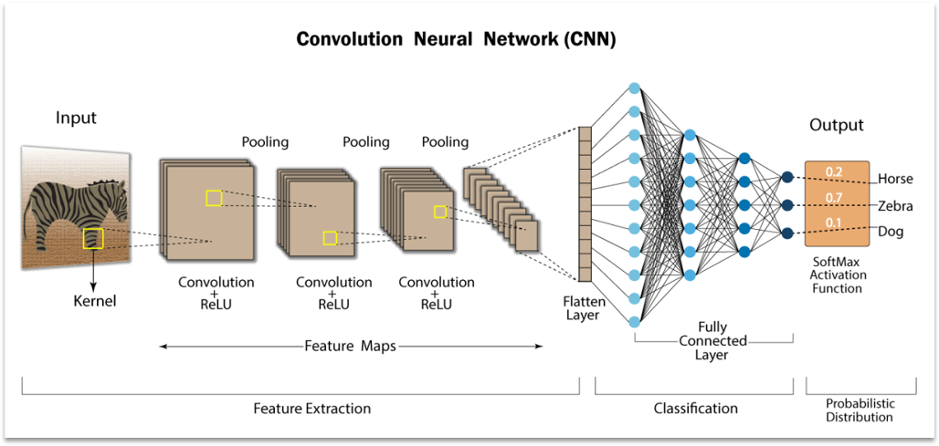
CNN Breakdown - Layers
Notes:
Furqan

Slide 7
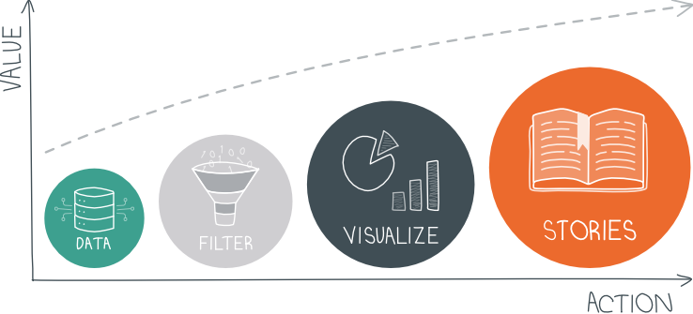
Code along – Do it yourself
Notes:
Felicity + Abdul

Slide 8
Any Questions?
admin@rockborne.com

